Slide 1







Web Programming 261
JavaScript DOM [Creating HTML Elements]

Slide 2
Outcomes
Students should understand the following outcomes, upon successful completion of this module:
Intro to the DOM
document.createElement()
appendChild()
Creating new HTML Elements
Paragraph
List
Table

Slide 3
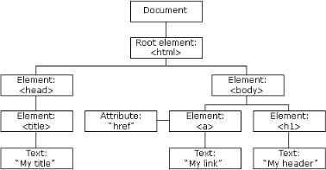
DOM
When a web page is loaded, the browser creates a Document Object Mode (DOM) of the page.
DOM, represents all page content as objects that can be modified.

Slide 4
Creating New Elements on the DOM
In JavaScript, we can create completely new HTML Elements (Nodes) from the app.js file.
This is useful when you want to dynamically update a page or build User Interfaces (UIs).
To add a new element to the HTML DOM, you must create the element (element node) first, and then append it to an existing element.
document.createElement() is a method in JavaScript that allows you to dynamically create an HTML element within the context of a web page.
It is part of the Document Object Model (DOM) API, which provides a structured representation of a web page's content and allows you to manipulate that content programmatically.

Slide 5

Creating New Elements on the DOM
Example 1: Lets create the following in HTML:
<body>
<p>Old Paragraph</p>
<div id="container">
<button id="addButton" onclick="addParagraph()"> Add Element
</button>
</div>
</body>
Index.html

Slide 6

document.createElement()
When the button is clicked, the JavaScript function should run
// Function to add a new paragraph function addParagraph() {
// Get references to the container div and the add button
var container = document.getElementById('container');
// Create a new <p> element
var newParagraph = document.createElement('p');
// Set the text content of the paragraph
newParagraph.textContent = 'This is a dynamically created paragraph.';
// Append the new paragraph to the container container.appendChild(newParagraph);
}
app.js

Slide 7
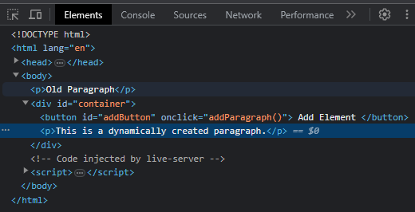
document.createElement()
In this JavaScript file (script.js), we:
Define a function called addParagraph().
Get references to the container <div> using document.getElementById(‘container’).
Create a new <p> element using document.createElement().
Sets the new text content of the paragraph.
Appends the new paragraph to the container <div> using container.appendChild(newParagraph).
Result:
The page includes a container <div> with an "Add Element" button.
An onclick attribute points to the addParagraph() function, which runs and as a result, a new paragraph with the text "This is a dynamically created paragraph." is added to the container.

Slide 8
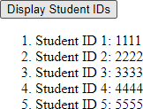
document.createElement()
Example 2:
Get 5 student IDs from the browser using prompt in JavaScript.
Use a displayStudentIDs() function, get each ID, store each in an array.
Create a <ol> element, and pass to it new <li> elements, which will then display IDs as follows:
Hint: make use of the onclick() attribute, loops, arrays, querySelector(), createElement(), appendChild() to achieve this.

Slide 9
Inline Event Handling Using onclick()
Solution:
Lets create the following in HTML:
<div>
<button id="displayButton" onclick="displayStudentIDs()"> Display Student IDs
</button>
</div>
<div class="student-list"></div>
Index.html

Slide 10
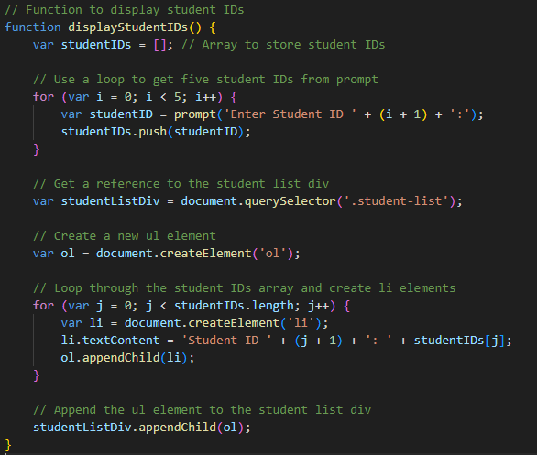
Solution:
app.js

Slide 11
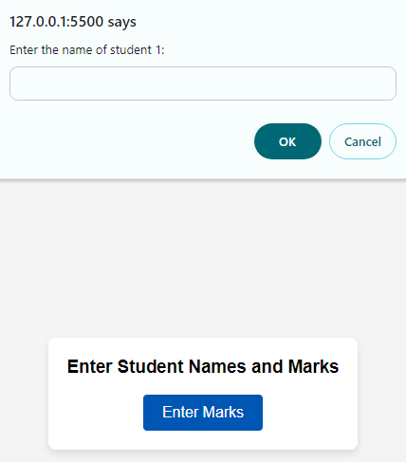
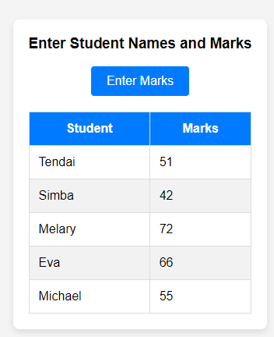
document.createElement()
Example 3:
Use the addendum provided to get 5 student names and their marks from the browser, using prompt in JavaScript.
Display the marks in a new table element:
Hint: make use of the onclick() attribute, loops, arrays, querySelector(), createElement(), appendChild() to achieve this.

Slide 12
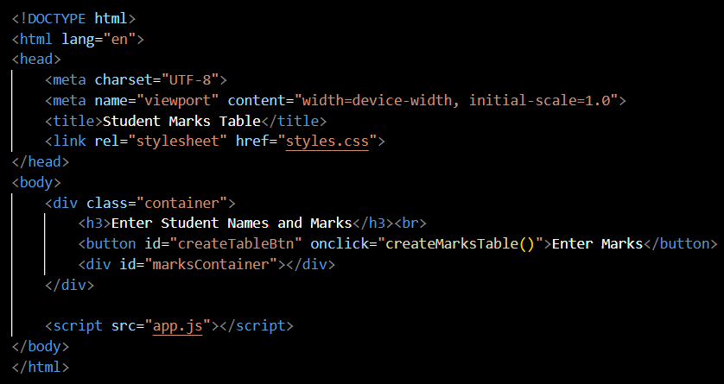
Solution:
Index.html
Use the CSS file in the addendum

Slide 13
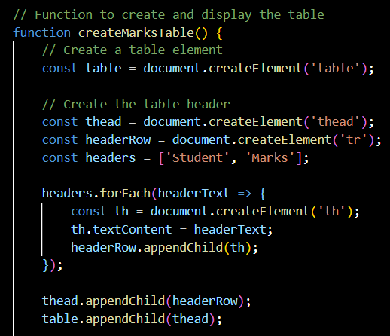
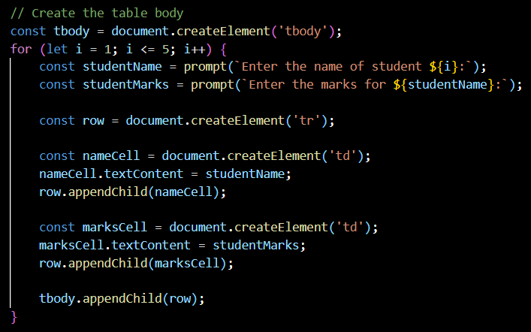
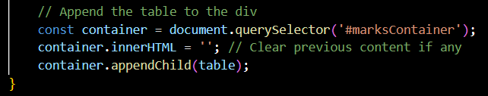
Solution:
app.js

Slide 14
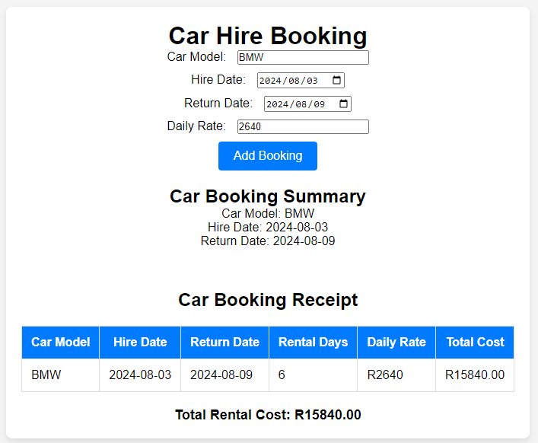
Exercise:
Use the addendum with the HTML and CSS and add functionality to the following website in JavaScript:
The website is a car booking application that adds a booking from details on the form.
Use JavaScript to add a new paragraph element to display the Car Booking Summary.
Use JavaScript to add a new table element to display all data of the booking as a receipt, including the total cost, as shown.

Slide 15







Thank You!
21
THE END
/belgiumcampusSA
#Belgium Campus
info@belgiumcampus.ac.za
+27 10 593 53 68
/belgiumcampus
www.belgiumcampus.ac.za
21

Slide 16
References
https://www.freecodecamp.org/news/here-are-the-new-built-in-methods-and-functions-in-javascript- 8f4d2fd794fa/
https://javascript.info/array-methods
https://www.tutorialrepublic.com/javascript-examples.php
https://ultimatecourses.com/blog/array-reduce-javascript

